Slide 1
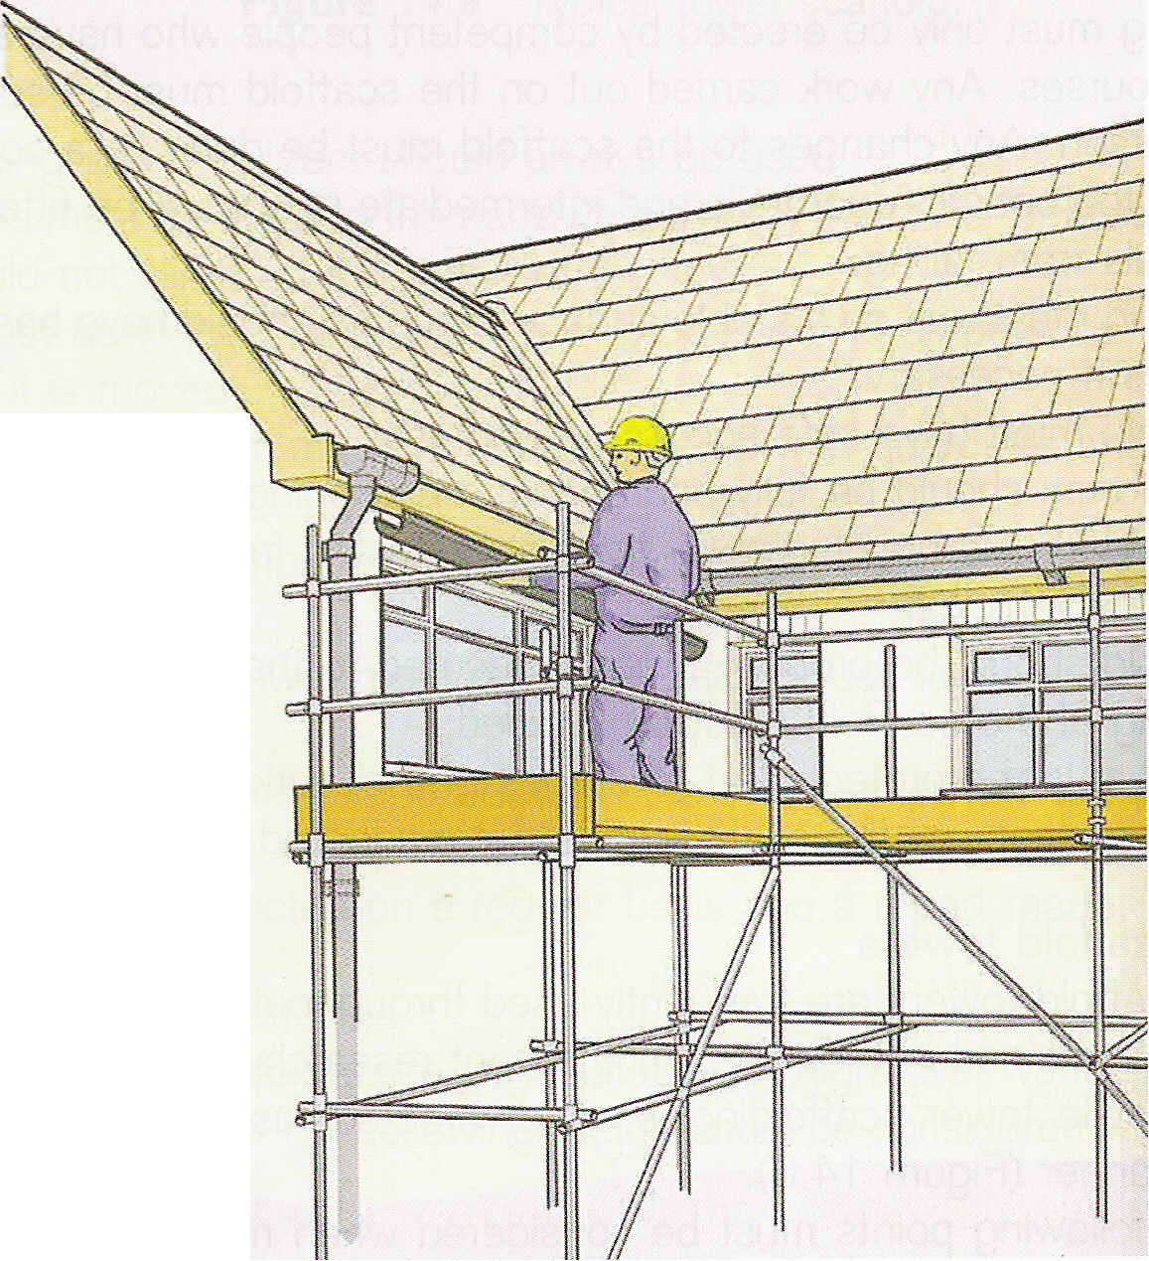
Health & Safety:
Prevention through planning, control and monitoring
Harold Chinogurei

Slide 2
AGENDA
Introduction to Health and Safety in Construction Industry - definitions
How to prevent Health and Safety Issues through
- Planning
- Control
- Monitoring
Policy Development
Conclusion

Slide 3
Scope of Construction
General building work;
Larger civil engineering projects;
Water supply & sewage schemes.
All of above could involve hazardous operations; or
Contact with hazardous materials.
Involvement of young persons requires strict supervision and safety arrangements, especially where on-site training is occurring.

Slide 4
Scope ........

Slide 5
What is Health & Safety about?
Preventing people from being harmed at work or becoming ill by taking the right precautions – and providing a satisfactory working environment.

Slide 6
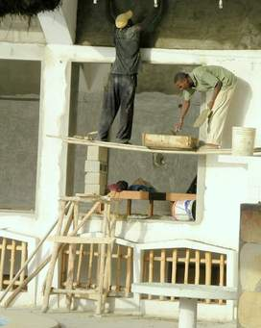
Advantages of Putting Health and Safety First!
Increased quality
Decreased scrap/waste
Increased employee morale
Decreased health care
costs
Decreased workers’
compensation costs

Slide 7
Root Causes for Accidents in Construction Sites
Inadequate construction planning
Lack of proper training
Deficient enforcement of training
Unsafe equipment
Unsafe methods or sequencing
Unsafe site conditions
Not using safety equipment

Slide 8
How can you help to get health and safety right?
Training
Training makes people safer and reduces accidents and incidents
Everyone needs some form of health and safety training:
Managers and supervisors need training to help them plan
‘Frontline’ employees need basic training, eg on safe systems of work

Slide 9
Enforcing Safety Management
The safety management team follows
“ PDCA” cycles to ensure safety at site.
PDCA stands for:
P- Plan
D- Do (Responsibility & Communication)
C- Check Act -review

Slide 10
Having a SAFETY POLICY
Ideally a H&S Policy should include :
Policy statement - What the organisation is trying to achieve in safety
Organisation of health and safety - Who has general and specific safety responsibilities
Arrangements for health and safety - How they will carry out their safety responsibilities

Slide 11
Policies should entail

Slide 12
Considering Safety During Design Offers the Most Payoff
Conceptual Design
Detailed Engineering
Procurement
Ability to Influence Safety
High
Construction
Start-up
Low
Project Schedule
The earlier safety is incorporated into the schedule the more influence it will have on the total project!
Notes:
The earlier safety is incorporated into the schedule the more influence it will have on the total project!
One of the reasons that the DfCS concept is so compelling is that all safety professionals know that it is much more effective to design safety into a process than it is to try to manage safety within a process that is inherently unsafe.
This chart has been adapted from the construction management literature. The ability to influence safety is on the vertical axis and the project schedule is on the horizontal axis. The chart shows that by including construction site safety as a consideration (along with production, quality, project scope, etc.) early in the project’s life cycle, one has a greater ability to positively influence construction site safety.
This concept is in contrast to the prevailing methods of planning for construction site safety, which do not begin until a short time before the construction phase, when the ability to influence safety is limited.

Slide 13
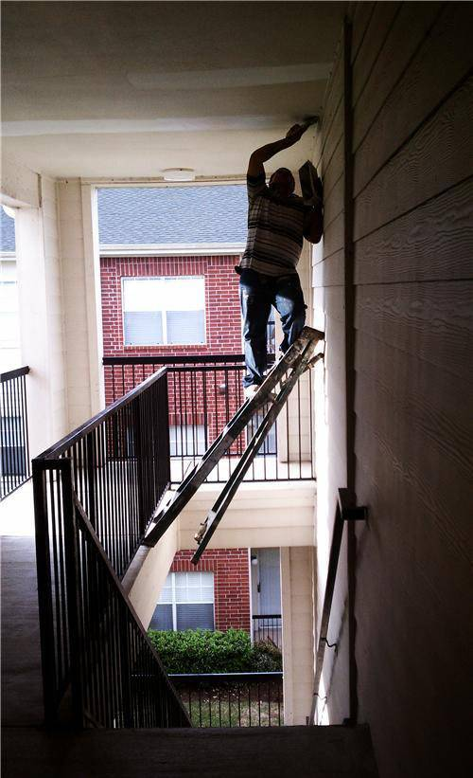

Slide 14
Contractor Pre-qualification
Must complete prequalification Incident rates
Experience Modification Rates (EMR)
OSHA recordable cases
General company information
Safety programs
Medical surveillance programs

Slide 15
What to look for in a Health & Safety Plan? Pre-tender Phase
• Nature of project
• List of significant hazards and control measures,
• All known information relating to construction site e.g;
services, traffic control and ground conditions
• Construction materials – precautions required,
• Problems that need specific discussions,
• Site rules; including access and accommodation
• Liaison arrangements (Client and planning supervisor)
• Procedures for dealing with design changes.

Slide 16
What to look for in a Health & Safety Plan? Construction Phase
• List of significant hazards and control measures,
• Identification of responsibilities
• Management and review arrangements,
• Resources,
• Contractor control procedures
• Site access arrangements,
• Methods for communicating (on-site and off-site)
• Emergency procedures.

Slide 17
Monitoring -Job Safety Task Analysis
As a project progresses, a job safety task analysis should be performed to make sure that the appropriate work and safety equipment is on hand.
The key elements, include:
Managing the risks by applying the general principles of prevention.
Appointing the right people at the right time;
Making sure everyone has the information, instruction, training and supervision they need to carry out their jobs in a way that secures health and safety;
Effective measures to secure health, safety and welfare.

Slide 18
Employers’ obligations
It shall be the duty so far as is reasonably practicable to ensure the health, safety and welfare at work of all employees and the employer should provide:
Healthy and safe systems at work
Healthy and safe working environment;
Safe plant, machinery, equipment & appliances;
Safe methods for handling, storing & transporting;
Adequate instruction, training and supervision;
Safe method of access to and egress from workplace.

Slide 19
Employers’ Obligation cont:
It is a moral and legal obligation of employers to provide a safe working place and of employees to work safely.
• Project runs on schedule as if any accident takes place it affects the work site and project may be delayed, therefore safety also takes care of time. Productivity will increase.
• There is an adverse effect on a contractor’s reputation and unfavourable image for the client when the project suffers high accident rates ; Therefore Company’s reputation will be better.

Slide 20
Safety Plan
Safety Plan - Hazards can be painful e,g using wrong tools for the job or using tools improperly, using improperly maintained tools, hand-intensive work. Identification of Activities that may cause Risks
Scaffolding
Concreting
Formwork
Use of ladder
Excavation
Welding
Bar bending
Loading & unloading
Earth moving equipment

Slide 21
Reviewing On-Going Operations
Conduct site safety inspections
Review training records and work permits
Review air monitoring data
Review how deficiencies are detected and corrected
Conduct progress meetings

Slide 22
Health & Safety File
Record of relevant information for the client.
developed as the construction progresses with various sub-contractors adding information as it becomes available.
Typical contents will include:
The location of services and instructions on any equipment or items fitted
Plans and drawings
Details of equipment in the building or structure
Equipment and maintenance procedures
Location of services and utilities, and
Manuals produced by specialist contractors and suppliers.

Slide 23
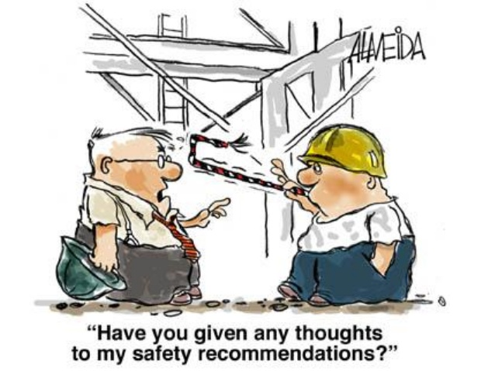
Conclusion

