Slide 1
CIFOZ Congress 2018
Presentation by
Infrastructure Development Bank of Zimbabwe (IDBZ)

Slide 2
The Presentation is in two parts:
Part A: Introduction and Mandate of IDBZ-
Mandate and key sectors:
Infrastructure funding requirements
Funding Gap
Comparisons with other African countries
Potential resources in the African context
What Zimbabwe need to reverse
Part B: Operational issues-
Role of IDBZ in infrastructure Projects
Implementation and Funding arrangements/options
Examples of projects
Opportunities through the Value Chain.
Introduction

Slide 3
PART A

Slide 4
IDBZ: Mandated to facilitate infrastructure development through resource mobilisation and capacity building in the following Sectors:
Energy
Transport
Water, Irrigation &
Sanitation
ICT
Housing/Social Infrastructure
Electricity Generation
Transmission
Lines
Hydro power
Solar
Roads
Airports
Railways
Marine
Backbone
Distribution infrastructure
Land development
Water & Sewer
Roads & drains
Electricity reticulation
Accommodation
Dams
Irrigation
Water pipelines

Slide 5
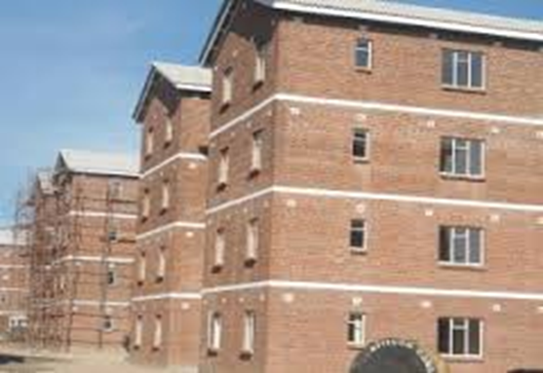
Magnitude Of Financing Requirements For Infrastructure In Zimbabwe- Minimum Gap Analysis
Energy:
US$4.3 B
-Power plants
-Transmission lines
-Renewable Energy
-Solar projects
Transport
US$5.6 B
-Roads
-Airports
-Rail
Urban link roads
Water & Sanitation
US$4.2 B
-Dams
-Irrigation
Treatment Plants
-Sewer
ICT
US$0.1 B
Communication systems
-Telephones Lines
-Internet Services
Housing/Social Infrastrcuture
More than 1.2 Million Units
-Water & Sewer
-Link roads
Electricity
Water
Student/Staff accommodation
IC
Total US$33 B in two decades. Translating to annual gap of US$1.7 billion. The Gap has since widened due to national budgetary constraints
Researches including IMF agree that there is a positive & significant relationship between infrastructure expenditure and output, growth and productivity.

Slide 6
Infrastructure funding levels against the requirements
Since 2010 to date the country has been allocating between US$200 Million and US$ 500 Million of public resources towards infrastructure against a financing requirement of over US$1.7 billion leaving a huge funding gap of over US$1.2 billion per year.

Slide 7
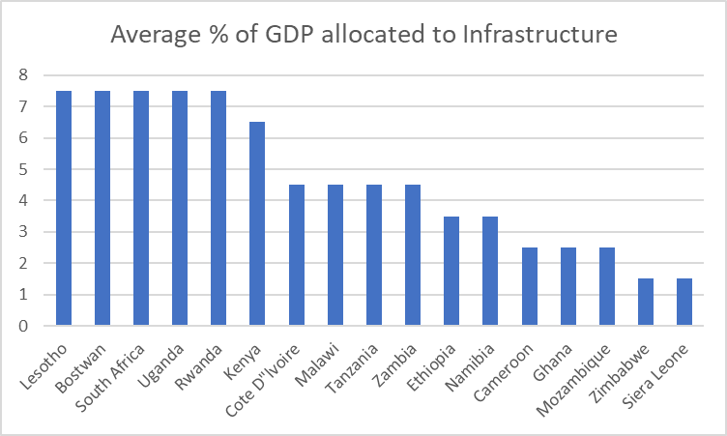
Comparison between Zimbabwe and selected African countries in terms of infrastructure financing Infrastructure Consortium for Africa (ICA) 2014a
Top performing countries (e.g. South Africa, Lesotho, Botswana) allocates around 7.5% of their GDP to infrastructure.
Zimbabwe and countries such as Sierra Leone allocate around 1.2% of GDP to infrastructure.
There is a need to reverse this trend.
Zimbabwe should aim to allocate well above 6% of its GDP towards infrastructure in order to close the existing gap.
Positive that the Transitional Stabilization Programme aims at increasing the share of resources allocated towards infrastructure.

Slide 8
Magnitude of resources available for in Africa that Zimbabwe may take advantage of if conditions are created?
Possible Funding sources | Magnitude (US$)
Official Development Assistance (ODA) | Over 50 billion (But dwindling)
FDI | Over 54 billion
International reserves | 400 billion
Diaspora remittances | Over 66 billion
Private Equity Markets | Over 30 billion
Potential earning from minerals | Over 168 billion
Lines of credit from banking sector | 60 billion
Pension Funds | Over 300 billion

Slide 9
Variables that makes Zimbabwe to be perceived as too risky. (Evidence from Africa Competitiveness Report- 2017
on a scale (0) to (30) with (o) representing best environment and (30) representing worst case scenario.
Policy instability challenges | 24.6
Access to Financing challenges | 14.5
Corruption related challenges | 12.7
Inefficient Government Bureaucracy | 11.2
Inadequate supply of infrastructure | 10.1
Restrictive labor regulations | 6.4
Tax rates | 5.1
Foreign currency regulations | 5.1
Government Instability | 3.3
Insufficient capacity to innovate | 2.4
Tax regulations | 1.8
Inflation | 1.3
Poor work ethic in national labor force | 0.8
Crime and theft | 0.5
Inadequate educated workforce | 0.1
Poor public health | 0

Slide 10
PART B

Slide 11
The Role of IDBZ in Infrastructure Projects
Project Preparation and Packaging:
Technical assistance on Feasibility Studies, project structuring, arranging project preparation finance, preparation of marketing/tender documentation (EOIs, RFPs, PIMs, etc.)
Project Financing:
Determination of suitable financing models, resource mobilization, negotiating funding terms/agreements with investors, administering funding arrangements, etc.
Procurement:
The Bank’s procurement system is geared towards delivering high quality and value for money goods, works, and services through sustainable cost savings. It seeks to promote fairness, best corporate governance practices and endear public confidence.
Project Implementation Monitoring:
Contracts management & administration: Validation of Contractor Certificates, handing Disbursements to Contractors/Suppliers, Project Inspections and Progress Reports, etc.

Slide 12
Implementation/Funding Arrangement Options
Joint Venture
Projects to be implemented through SPV jointly owned by the two parties
BOT
IDBZ constructs and operates facilities under a concession over a period of time
Outright Sale
Council sells land to the Bank (particularly for housing projects)
Loan
Certain revenue streams ring-fenced to repay the loan

Slide 13
Project Development & Preparation Fund (PPDF)
The Bank recognizes that the lack of bankable projects remains a major challenge which militates against efforts to attract investment towards priority infrastructure projects
In response, the Bank established PPDF to finance project preparation and development processes such as layouts, designs, EIA and Feasibility Studies
Started off with seed capital of US$2.5m but now increased to US$10m

Slide 14
Examples of Projects Being Undertaken
ProjectPhase | Description | Project Cost (US$) | Status
Clipsham Views – Masvingo | Servicing of 704 low density stands | 6,700,000 | Completed
Bulawayo Students Accommodation Complex | Student Hostels (1032 beds) and commercial centre | 12,000,000 | Construction in progress
ZETDC Prepaid Metering | Installation of 800,000 prepaid meters | 45,000,000 | Completed
Victoria Falls WASH | Water and Sewer augmentation | 12,000,000 | Resource Mobilisation
New Marimba Housing | Servicing of 340 residential stands | 3,600,000 | Completed PHASE 1
Empumalanga West Housing and Sewer Treatment Plant | Servicing of 2,300 residential stands and rehabilitation of sewer treatment plant | 6,000,000 | Construction in progress
Chiredzi WASH | Water and Sewer Augmentations | 9,700,000 | Feasibility Studies in progress
Kariba Housing | Servicing of 1560 mixed density stands | 15,000,000 | Construction in progress

Slide 15
Infrastructure Value Chain Finance (IVCF)
About IVCF
Infrastructure value chain financing is the provision of financial services and products to the energy, water and sanitation, transport, ICT and housing sector players to address growth constraints.
Overall Objective
The overall objective of this product is to promote infrastructure development in Zimbabwe by enhancing the capacity of key players in the infrastructure value chain to improve their effectiveness and efficiency in their operations.
Specific Objectives
to provide working capital and capital expenditure/ asset finance for players in the infrastructure value chain.
to support players in the infrastructure value chain by providing bank guarantees (bid bonds, performance bonds, advance payment guarantees, maintenance/ retention bonds).
to provide advisory services to players in the infrastructure value chain (business plans and funding proposals).

Slide 16
Infrastructure Value Chain Finance (IVCF) cont’d
Eligible / Qualifying projects
Support will be rendered to players in the energy, water and sanitation, housing, transport and ICT sectors.
The eligible activities include:
construction and maintenance of road, rail and airport, equipment and materials;
water and sewer reticulation; equipment and materials;
improvement in existing power generation, transmission and distribution systems;
renewable energy equipment (wind, solar, hydro, geothermal, biomass and biogas power projects);
housing (roofing materials, cement manufacturing, quarry, bricks and related products); and
ICT back bone infrastructure, base stations, mobile money transfer platforms, equipment and related materials.
Respect of sustainable development (Climate, gender, social etc)
Note
The Bank shall NOT fund projects of a re-financing nature. Priority shall be given to those players that are directly involved in infrastructure development. Instruments used to implement the product.

Slide 17
Infrastructure Value Chain Finance (IVCF) cont’d
The instruments include:
structured finance packages;
bank guarantees;
pre-and post shipment finance to exporters and importers;
asset finance;
bankers acceptances;
bridging loans;
working capital short term loans (up to 12 months);
capital expenditure medium term loans (up to 24 months);
order financing;
invoice discounting; and
debt factoring.
Collaboration Opportunities
There is scope for; collaboration with other banks through syndication, and JVs with; municipalities, road authorities, government departments and private sector.

Slide 18
Infrastructure Value Chain Finance (IVCF) cont’d
Eligibility Criteria
The Bank will support those projects that are consistent with the Bank’s mandate of infrastructure delivery and lie within the focus sectors. In addition the projects should be financially sound and operating sustainably. The Bank will only lend to projects that are able to service their debts within an agreed time frame. Furthermore, the projects should be socially, economically, technically feasible and environmentally sustainable. In summary, the projects to be supported should fit the following criteria:
The beneficiary should have been in business for at least three years;
minimum facility thresholds of US$ 100 000;
preferably two year audited financial statements or;
cash flow projections covering the tenure of the facility; and
the firm should be a legal entity registered in Zimbabwe.
Tenor
Short term – 12 months
Medium term – up to 24 months

Slide 19
Infrastructure Value Chain Finance (IVCF) cont’d
Pricing
Pricing will be guided by the RBZ guidelines on pricing from time to time . However, the Bank ensures that its pricing is competitive, reflective of market conditions.
The general conditions are as follows:
Interest rate - 8% to 10 % p.a.;
Arrangement fee - 1.5% to 2% (flat); and
Guarantees, the commission is between 1.5% and 2% once off and 0.25% quarterly.
How to apply
There is need for a business proposal which is in line with the Bank’s funding requirements check list available at www.idbz.co.zw or can be obtained from the Bank. The business proposal should be accompanied by an application letter which states the borrower’s needs.
Customer Due diligence
The Bank consider the following when extending to its customers:
Adherence to good corporate governance practice;
Valid borrowing powers obtained from the responsible authorities/ board resolution;
Audited financial statements;
Compliance with statutory requirements in the sector;
Other Know Your Customer (KYC) considerations; and
Compliance with Anti Money Laundering and Terrorist Financing(AMLTF) principles.

Slide 20
Thank you
Tatenda
Siyabonga
Twalumba

