Slide 1
ROLE OF THE RESERVE BANK IN INFRASTRUCTURE DEVELOPMENT
Presentation By:
SAMUEL TARINDA
DEPUTY DIRECTOR RESERVE BANK OF ZIMBABWE
AT THE
CIFOZ ANNUAL CONGRESS
Victoria Falls, 25-28 OCTOBER 2018

Slide 2
PRESENTATION OUTLINE
INTRODUCTION
ZIMBABWE’S INFRASTRUCTURE & FINANCING GAP
POLICY THRUST TOWARDS INFRASTRUCTURE DEVELOPMENT
FINANCING OF INFRASTRUCTURE
CONSTRUCTION OPPORTUNITIES IN INFRASTRUCTURE DEVELOPMENT
CONCLUSION

Slide 3
INTRODUCTION
Infrastructure is critical to delivering growth, reducing poverty and addressing broader development goals;
It includes public investment in physical assets and social services or “social overhead capital” as Development Economists put it”,.
It increases economic growth directly through increased construction activities and employment;
Indirectly increases business opportunities by making investments more productive, reducing transactions costs, promoting communications, and creating economic and social interactions.

Slide 4
INTRODUCTION
It can also be treated as a factor of production or simply be regarded as a direct input into the production process;
Infrastructure can also act as a stimulus to aggregate demand.
In this regard, governments across the globe often use large-scale infrastructure projects as stimulus policies during recessions or in order to achieve particular growth targets:
An example, closer home, is South Africa’s Expanded Public Works Programme (EPWP) which has been instrumental in raising aggregate demand in South Africa.

Slide 5
STATE OF INFRASTRUCTURE IN ZIMBABWE
Zimbabwe used to have one of the most developed infrastructure in terms of coverage and quality in sub-Saharan Africa.
Over the last decade, however, limited investment in maintenance and expansion has led to a deterioration in the country’s infrastructure, with adverse consequences on service delivery and industrial competitiveness.
The challenge has been compounded by limited access to long term external credit, particularly foreign direct investment (FDI).
Although the country ranks poorly in global in infrastructure competitiveness, it however, compares favourably with some peers in the SADC region.

Slide 6
Regional Competitiveness (Infrastructure) Index 2017–2018
At 116 out of 137 countries, Zimbabwe ranks poorly in terms of Infrastructure Competitiveness.
Though standing right at the middle of competitiveness rankings in SADC, the country’s infrastructure significantly lags behind Malawi, Madagascar and Mozambique.

Slide 7
Global Competitiveness Index 2017–2018: Infrastructure Ranking
 | 2015-16 | 2017-18
Description | Rank/140 | Rank/137
Quality of overall infrastructure | 121 | 115
Quality of roads | 98 | 116
Quality of railroad infrastructure | 83 | 86
Quality of port infrastructure | 102 | 108
Quality of air transport infrastructure | 115 | 104
Available airline seat km/week, millions | 120 | 120
Quality of electricity supply | 132 | 112
Mobile telephone subscriptions/100 pop | 115 | 115
Fixed-telephone lines/100 pop | 114 | 109
Though slightly improved since 2015, Zimbabwe’s ratings remain generally poor across all aspects of key infrastructure indicators.

Slide 8
STATE OF INFRASTRUCTURE IN ZIMBABWE (2)
In 2011, the African Development Bank estimated that Zimbabwe requires about $14.2 billion for infrastructure rehabilitation and development.
Government has since updated the country’s infrastructure funding requirements to close to US$30 billion.
Government capital expenditure in 2017 was US$1.34 billion, representing 22% of total expenditures, but minimal amounts went into infrastructure.

Slide 9
Structure of Government Expenditure in 2017

Slide 10
POLICY THRUST TOWARDS INFRASTRUCTURE DEVELOPMENT
Successive Government economic blueprints have prioritized Infrastructure development, given its centrality in the economic and development matrix, as a key enabler.
The Transitional Stabilisation Programme (TSP) recognizes the critical role played by a functional public infrastructure, in unlocking economic growth potential, increase competiveness and productivity, and enhancing service delivery.
The Programme prioritises quick-win projects in energy, water and sanitation, ICT, housing and transport, with focus on expediting completion of ongoing infrastructure projects.
The TSP targets increasing the Budget on capital expenditures to over 25 percent, with more allocations towards infrastructure development.

Slide 11
TYPE OF INFRASTRUCTURE | PROJECT DESCRIPTION | ESTIMATED COST (US$ MILLION)
Electricity | Thermal power: Hwange expansion, Byo, Gwayi, Gokwe North Hydro: Batoka hydro, Solar: Gwayi, Mutoko Transmission and Distribution network | 12,188
Roads Dualization | Harare ring (80km) Harare-Masvingo-Beitbridge (575km) Harare-Chirundu (352km) Harare-Nyamapanda (238km) Bulawayo-Beitbridge (322km) Bulawayo- Victoria Falls (439km) | 2,242
Rail Network Rehabilitation | Track repair, communication, locomotives, coaches | 2,131
Airports Rehabilitation and Development | Robert Mugabe International Airport, Weather observation, Runway Joshua M. Nkomo Airport New control tower Traffic control, Communication, Navigational aids | 180
Water and Sanitation | Harare and Bulawayo Water works; rehab and upgrade Sewerage; rehab and upgrade | 2,349

Slide 12
FINANCING OF INFRASTRUCTURE
The Reserve Bank superintends over financial institutions, which in turn play a catalytic role in infrastructure financing and development.
Building Societies and the Infrastructure Development Bank of Zimbabwe (IBDZ) play a more direct role in infrastructure financing.
Commercial and Merchant Banks provide supplementary financing for infrastructure, through dedicated units and products.
The Banking & Financial Sector designs and offers innovative financing products and services to the infrastructure sector.

Slide 13
Trends in Building Societies Mortgage Financing (US$)
Most Housing Projects are financed through bank mortgages, as well as other external facilities.
Banks provide working capital and other short-term financing, mainly to the construction sector, and other value chain players in infrastructure development.
Takeover of NPLs by ZAMCO

Slide 14
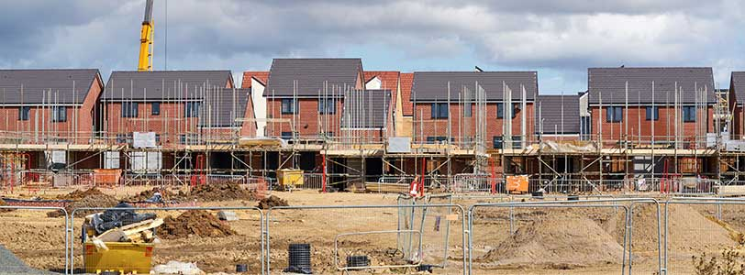
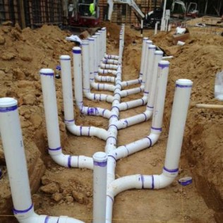
Infrastructure Financing – Supply and Value Chains

Slide 15
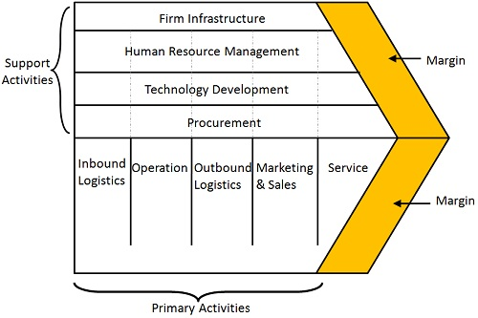
Infrastructure Value Chain Financing
Banks and other Financial Institutions are involved in financing at each stage of the Value Chain.

Slide 16
Infrastructure Financing Instruments & Options
Infrastructure Bonds
Use of infrastructure bonds have also become common to finance infrastructure in developing countries.
The infrastructure bonds can be raised from the domestic markets or international capital markets.
Government will, under the TSP, revive the issuance of bonds through the development of a secondary bond market, beginning 2019.
The funds unlocked through these bonds provide opportunities for building contractors to participate in the targeted infrastructure projects.

Slide 17
Infrastructure Financing Instruments & Options
Sovereign Bonds
Other African Governments have resorted to international markets to finance infrastructure projects.
Part of the bond proceeds are used to clear arrears with bilateral and multilateral creditors, which helps to unlock new and additional funding for long term infrastructure projects.
According to the UK-based Overseas Development Institute (ODI), Sub-Saharan Africa sovereign bonds increased from $6 billion in 2012 to a record $11 billion in 2014.
First to test the waters was Seychelles, which in 2006 was the first in sub-Saharan Africa, outside South Africa, to issue sovereign bonds. It was quickly followed by Ghana ($750 million in 2007); and later joined by Ethiopia ($1.5 billion in 2014); Kenya ($2 billion in 2014); and others (Côte d’Ivoire, Nigeria, Rwanda, Namibia and Zambia).

Slide 18
Infrastructure Financing Instruments & Options
Public Private Partnerships (PPPs)
The Joint Venture Act Zimbabwe (Chapter 22 of 2016) is now operational, and a Joint Venture Unit was established within the Ministry of Finance.
The Act provides a framework for guiding PPPs in many spheres of economic and development ventures.
Successful PPPs in some countries have been underpinned by supplementary documents, resource materials and manuals outlining the institutional arrangements and capacity building of public officials involved in implementing PPP projects.
Infrastructure investment, rehabilitation, maintenance and development are fertile grounds for implementing PPPs and joint ventures.

Slide 19
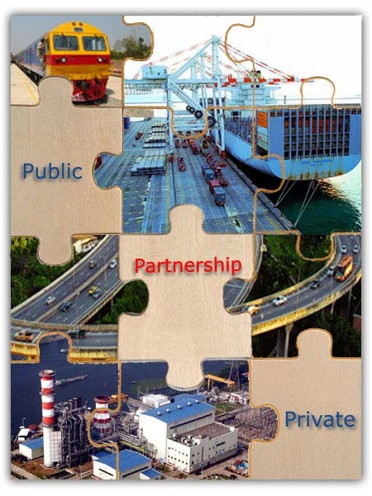
Infrastructure Financing: PPPs
PARTNERSHIP OF:
Resources
Risks
Returns
Rewards

Slide 20
Infrastructure Financing Instruments & Options
Tapping into Diaspora
Government is exploring ways to tap into diaspora remittances to fund and develop infrastructure.
Current efforts by Reserve Bank of Zimbabwe to incentivise diaspora inflows will ensure that the remittances are received through formal channels making it easier to tap them into infrastructure projects.
This will enhance and expand sources of financing infrastructure in the country, and provides additional platform for participation of building contractors.

Slide 21
Infrastructure Financing Instruments & Options
User Fees Infrastructure Financing Model
The transport infrastructure can also be financed through user fees, where the greater proportion of costs can be recouped from the users e.g. the Harare- Beitbridge Road; Beitbridge-Chirundu; etc. are partly self-financed through toll fees.
Other types of financing take the forms of Build, Operate and Transfer (BOT, BOOT).
These projects provide significant subcontracting opportunities to local construction industry players.

Slide 22
OPPORTUNITIES FOR THE CONSTRUCTION INDUSTRY
The current huge infrastructure gap in the economy presents significant upside opportunities for building contractors in the country.
There are significant opportunities for building contractors to participate in the rehabilitation, maintenance and expansion of infrastructure in the area of roads, railways, air, water, ICT and energy (hydro, thermal, solar, wind, etc).
Regional Infrastructure Initiatives – e.g. by AfDB and DBSA - launched the Africa50 Infrastructure Investment Platform designed to significantly narrow the infrastructure finance gap in Africa. This is an avenue for foreign exchange generation.
Africa50 focuses on the high-impact national and regional projects in the energy, transport, ICT and water.

Slide 23
Opportunities from International Re-Engagement
Successful engagement with the IFIs will undoubtedly increase the participation of development and cooperating partners into infrastructure development in the country.
The anticipated new funding from multilateral institutions towards infrastructure development will provide opportunities for building contractors to take part in unfolding infrastructure projects.

Slide 24
CONCLUSION
The provision of adequate infrastructure and related services is indispensable for economic development.
The adequacy of infrastructure helps to determine a country’s success or failure in diversifying production, coping with population growth, reducing poverty and improving environmental conditions.
The huge infrastructure gaps in the country, while providing immense opportunities for the private sector, however, show that the task of developing infrastructure can no longer be left to the Government alone.
Government involvement critical – public nature of most infrastructure.

Slide 25
THANK YOU

