Slide 1

Regional Opportunities in Zambia, Key Lessons, The Experiences of ZAMBIA
Presented by Hon. Derick Livune
Ambassador
Embassy of the Republic of Zambia
Harare

Slide 2
Zambia and its Neighbors

Slide 3
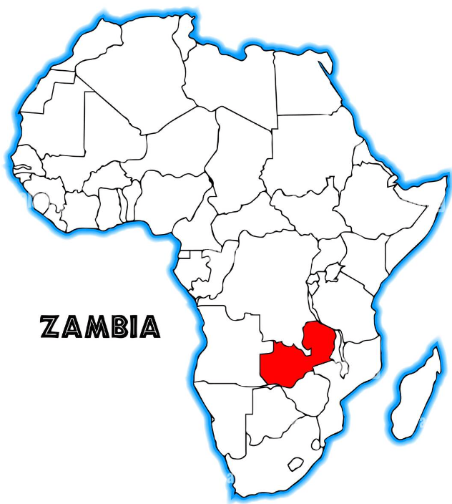
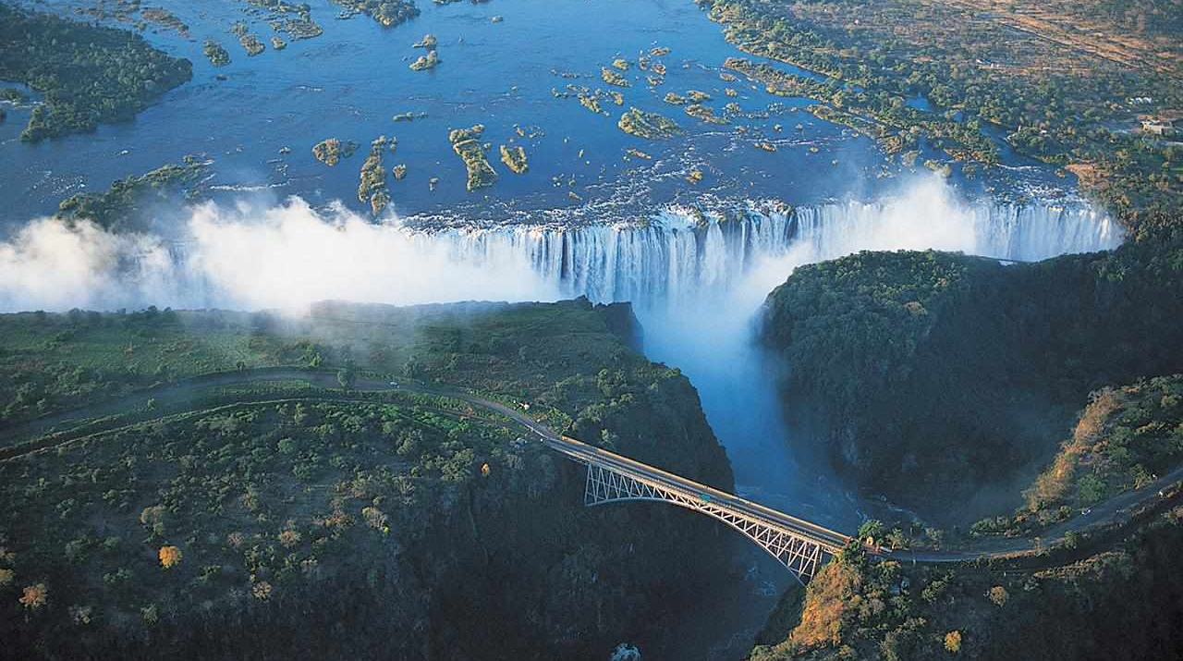

ZAMBIA IN BRIEF
About Zambia
Zambia is a land-linked country
situated at the Centre of southern African Sub-region
Separated from Zimbabwe by the Zambezi River
Zambia has a population of about 21.141 million people (2021)
Capital and largest city is Lusaka
The annual population growth rate is 2.75%
Area 743, 390 square kilometres of which 9,220 km² is water.

Slide 4
13 facts about Zambia
1. World’s largest Mammal Migration (Kasanka)
2. World’s largest Man made lake (Kariba)
3. World’s largest Emerald Mine
4. World’s second largest Wildbeest Migration (Liuwa)
5. Africa’s Second largest National Park (Kafue)
6. Africa’s Second Deepest River (Kabompo)
7. World’s largest Water Falls (Musi Oa Tunya)
8. World’s largest Concentration of Hippos
9. World’s only point where 4 countries meet (Kazungula)
10. One of the World’s Natural 7 wonders (Victoria Falls)
11. World’s second Deepest fresh water lake by Volume (Tanganyika)
12.Second largest Copper producer in Africa
13. Zambia boasts 20 national parks and reserves, 34 management areas and protects over 30% of its land.

Slide 5

WHY ZAMBIA?
Resource ENDOWED
ZAMBIA IS READY FOR BUSINESS
STABLE GOVERNANCE
Zambia's economy has historically been based on the Copper Mining Industry.
Zambian Government is undertaking economic diversification to reduce the country's reliance on the Copper Industry and exploit other components of Zambia's rich resource base by promoting Agriculture, Tourism, Gemstone Mining, Solar Energy, Thermal power and Hydro Power generation.
The government has made investment environment more transparent and accountable and anchored on consistent investment policies that ensure protection of private investment rights, zero tolerance to corruption.
1. Political stability since attaining independence in 1964
2. One of Africa's most peaceful, tolerant and democratic states with extremely low levels of crime.
3. Democratic government and sound governance structures based on the rule of law and respect for private property. Elected government officials, Parliamentary system.
4. Independent judiciary with established court systems with separate commercial courts
5. Strong anti-corruption measures have been instituted

Slide 6
WHY ZAMBIA?
ZAMBIA IS READY FOR BUSINESS
NATURAL RESOURCES
MARKET ACCESS
The government signed the trade agreements
East and Southern Africa (ESA) – EU Economic Partnership Agreement (EPA) development
COMESA-EAC-SADC Tripartite Free Trade Area (TFTA)
African Continental Free Trade Area (AfCFTA).
The Zambian Government signed and is currently implementing a number of bilateral trade agreements with Angola, United Republic of Tanzania, Zimbabwe Democratic Republic of Congo, China, Canada, United States and Japan.
The Trade and Investment Framework
Zambia has vast resource endowment in terms of land, labour and water, indicating the high potential to expand and/or excel
About 58% (42 million hectares) of land is classified as medium to high potential for agricultural production.
Zambia stands out as one of the prime tourism destinations in Africa offering a wealth of natural tourism assets
Endowed with a rich and diverse culture with more than 30 colorful traditional ceremonies.
1. A liberal economic and trade policy since 1991.
2. Has membership to the World Trade Organization (WTO), the Common Market for Eastern and Southern Africa (COMESA) and Southern Africa Development Community (SADC) Free Trade Areas (FTA).
3. One of the most open economies in the world.

Slide 7
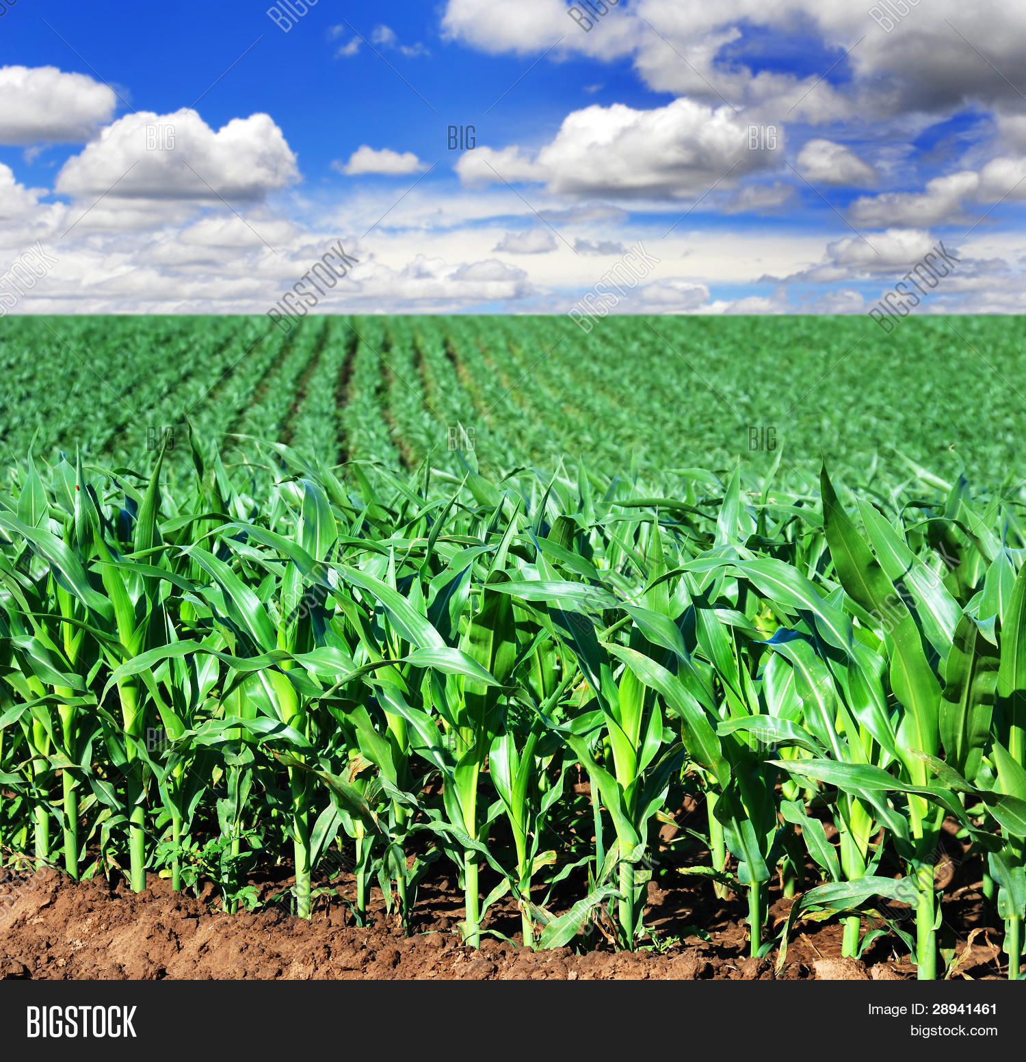
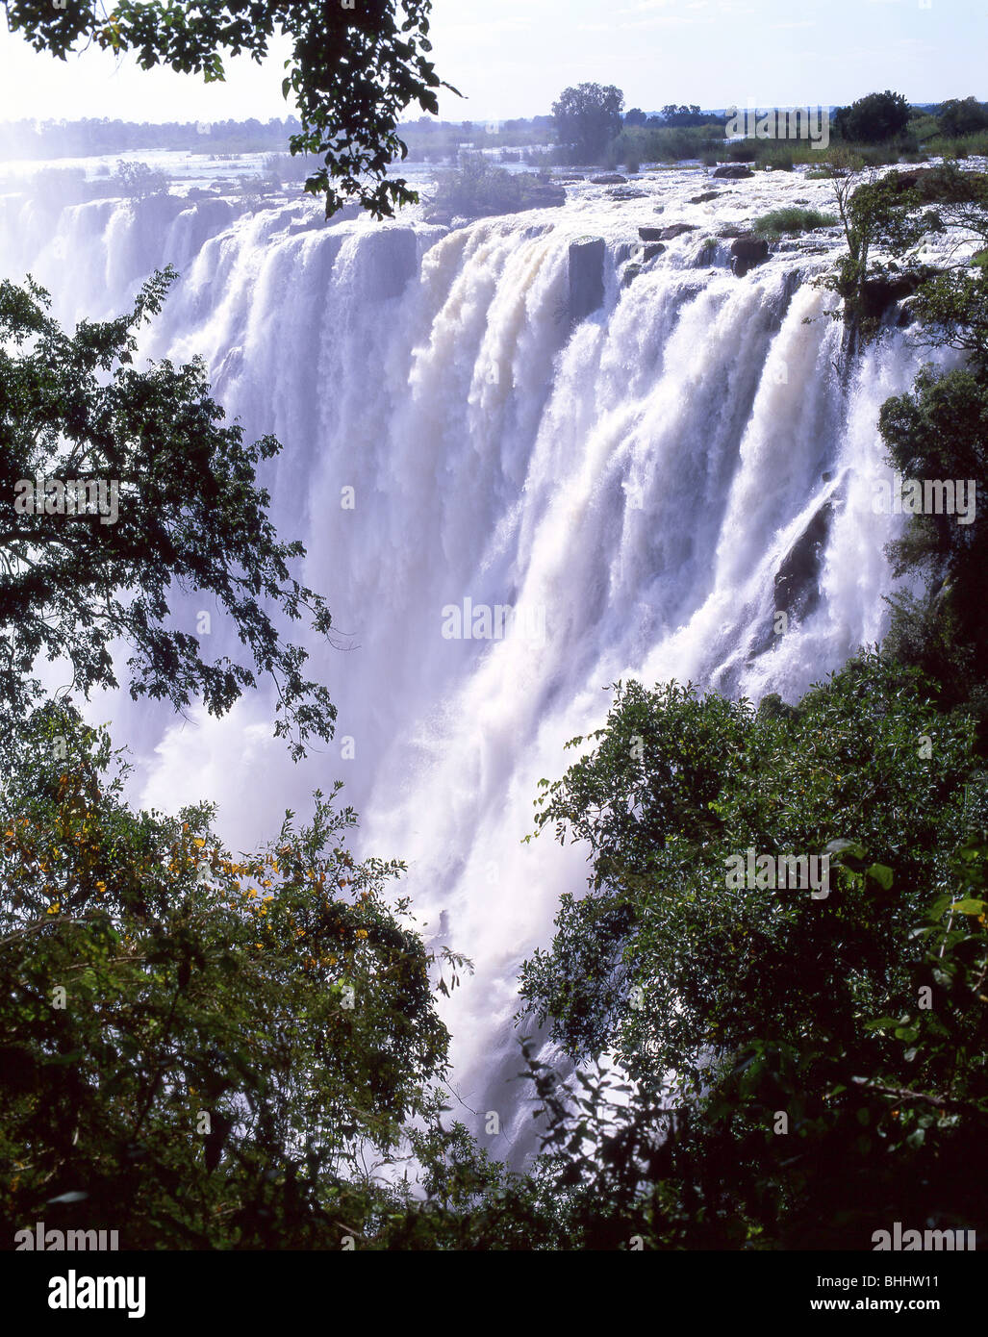
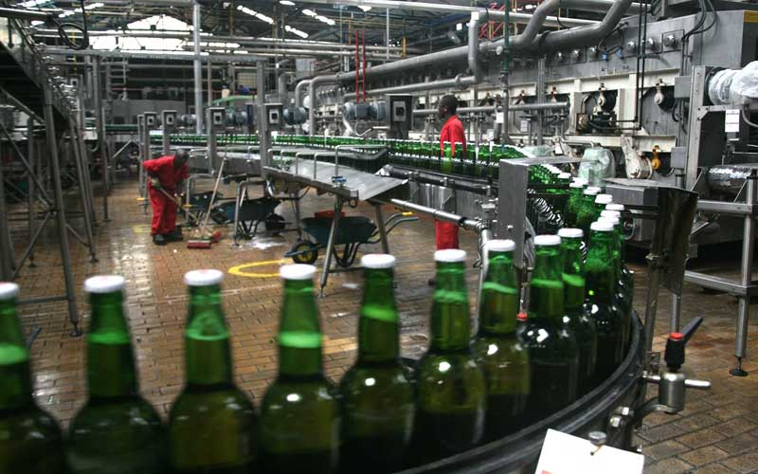
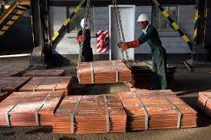
01
01
The Zambian Economy
The economy is anchored on these four main sectors.
1. AGRICULTURE
02
02
03
04
04
TOURISM
MANUFACTURING
MINING

Slide 8
MARKET AND TRANSPORT OPPORTUNITIES
In October 2023, the U.S. government, European Union, Africa Finance Corporation (AFC), African Development Bank, and the governments of Zambia, Angola, and the Democratic Republic of Congo (DRC) signed a seven-party memorandum of understanding (MOU) to formalize their shared commitment to develop a modern rail line connecting the mineral rich regions of the DRC and Zambia to Angola’s Port Lobito, on the Atlantic Ocean.
The project feasibility study is projected to be completed by Q1 2025.
The Lobito-Zambia rail line will provide a critical trade corridor for Zambian and DRC imports and exports.
Construction of the rail line will create ample opportunities for construction and related service contracts.
The MOU also calls for the project to promote sustainable investment along the corridor in the agriculture, energy, ICT, public health, and other sectors.

Slide 9
Kazungula Bridge
Would link, open up markets in eight African countries
Its location traverses the intersection of the Zambezi and Chobe rivers and at this point, two countries - Botswana and Zambia.
The bridge and one-stop-border-post facilities aims to enhance regional trade, integration and spur global competitiveness
The development was initially meant to be a tripartite arrangement on the North-South Corridor within the SADC region and is part of a corridor-long infrastructure improvement programme, to enhance regional trade and integration.
The Kazungula Bridge Authority located in the Republic of Botswana is a body corporate with perpetual succession and a common seal, capable of suing and being sued in its corporate name and with powers, subject to the provisions of this Act, to do all acts or things that a body corporate may, by law, do or perform.

Slide 10
Kazungula Bridge cont.
Kazungula Bridge Authority located in the Republic of Botswana instituted on 16th August, 2024 established under Article 3 of the Agreement. No. 12 of 2024 is mandated to oversee the operations and functions of the bridge.

Slide 11
TRADE OPPORTUNITIES
In order to facilitate cross border trade and accommodate movement of people and tourists;
Zambia Revenue Authority proposed to extend operating hours at Victoria Falls Border Post with the Republic of Zimbabwe from 06:00 hours to 22:00 hours to 24:00 hours.
Chirundu One-Stop Border Post operates 24 hours a day as the two sister countries seek to enhance intra-Africa trade.
Chirundu OSBP also responds to the surge in volumes of feeder traffic from Beitbridge and Forbes border posts as well as traffic from the sister countries.

Slide 12
NAMAFULO-BINGA BORDER POST
The Namafulo-Binga border post was developed to ease movement for Zambians/Zimbabweans crossing to Zimbabwe/Zambia on Lake Kariba in Sinazongwe District in Southern Province and Matabeleland North Province.
The border post eased the problem of people who were finding it difficult to obtain permits to cross to Zimbabwe/Zambia on Lake Kariba.
The border post opened up business opportunities for people wanting to conduct cross border trade and developing surrounding towns through tourism.
The border post also opened trade links between Binga and Maamba town in Zambia across the Zambezi river with connecting the Tonga people on either side thereby enhancing unity between the two neighbouring countries.

Slide 13
TOURISM OPPORTUNITIES
Zambia’s tourism sector is based on its environmental diversity which includes the Victoria Falls, vast wildlife resources (20 national parks), wilderness, cultural tourism, adventure activities and hunting.
President Dr. E.D. Mnangagwa, President F.J. Nyusi and President Hakainde Hichilema signed the Memorandum of Agreement (MoA) for Zimbabwe, Mozambique and Zambia (ZIMOZA) Transfrontier Conservation Area (TFCA) on 18th July 2024 at State House in Harare, Zimbabwe.
ZIMOZA aligns with the SADC Protocols on Wildlife Conservation and Environmental Management, promoting the conservation of shared wildlife resources through the establishment of TFCAs with the aim to protect a variety of endangered species such as elephants, hippopotamus, buffalo, lion, leopard, sable and roan and over 300 bird species.

Slide 14
Construction of Lion’s Den–Kafue Railway Project and the Bilateral Rail Transport Agreement
In another development, in 2023 in Bulawayo, the Permanent Secretary Ministry of Transport and Logistics Eng. Fredrick Mwalusaka and the Permanent Secretary, Ministry of Transport, Communication and Infrastructural Development, Zimbabwe, Eng. Amos Marawa held preliminary meetings on the Kafue – Lion’s Den Project that envisages the construction of a new railway line to link Lion’s Den in Zimbabwe with Kafue in Zambia, where it joins the Zambia Railway Network.
Both countries are to expedite internal processes to facilitate conclusion and signing of the MoU and the Agreement by December 2024

Slide 15
LOWER ZAMBEZI-MANA POOLS TFCA
On 26th May, 2023, Hon. Rodney Sikumba, Minister of Tourism, Zambia and Hon. Mangaliso Ngobizitha Ndhlovu, Minister of Environment, Climate, Tourism and Hospitality Industry, Zimbabwe signed a Memorandum of Understanding (MoU) on the development of the Lower Zambezi-Mana Pools Transfrontier Conservation Area (LOZAMAP-TFCA).
Zambia may open a pipeline through Zimbabwe to transport gas and oil products from the port of Beira, Mozambique. Based on this, a team from Zambia Energy Regulation Board (ERB) lead by Mr. Reynolds C. Bowa visited Zimbabwe in 2023 to discuss on the importation of oil and liquefied natural gas (lNG) from port of Beila through Zimbabwe as a storage facility and then to Zambia and on a long run, construct a pipe line to be extended from Zimbabwe to Zambia.

Slide 16
ZAMBIA AND ZIMBABWE PROJECTS
The construction and implementation of the Batoka Gorge Hidro Power station.
Ongoing rehabilitation works on the Kariba North and South Power Project dam wall rehabilitation. There is need for Zambia and Zimbabwe to expedite engagement to resolve management issues of the Kariba dam.
Kanyemba road and Kanyemba border post being upgraded, widened and constructed to improve the transport and trade route

Slide 17
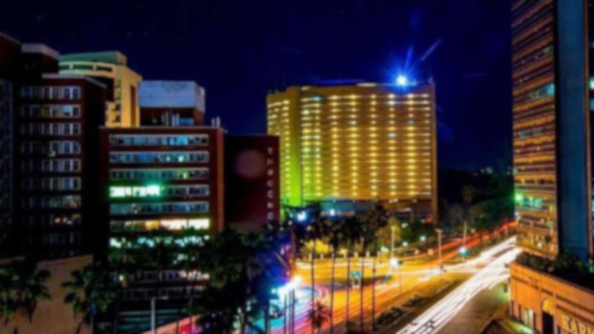

Conclusion
There is a need to take advantage of the two Countries’ aim to transform into Economic Prosperity and the levels of peace that can provide peace building and investment insights.
There are no stringent visa Requirements between Zambia and Zimbabwe and companies should take advantage of that.

Slide 18

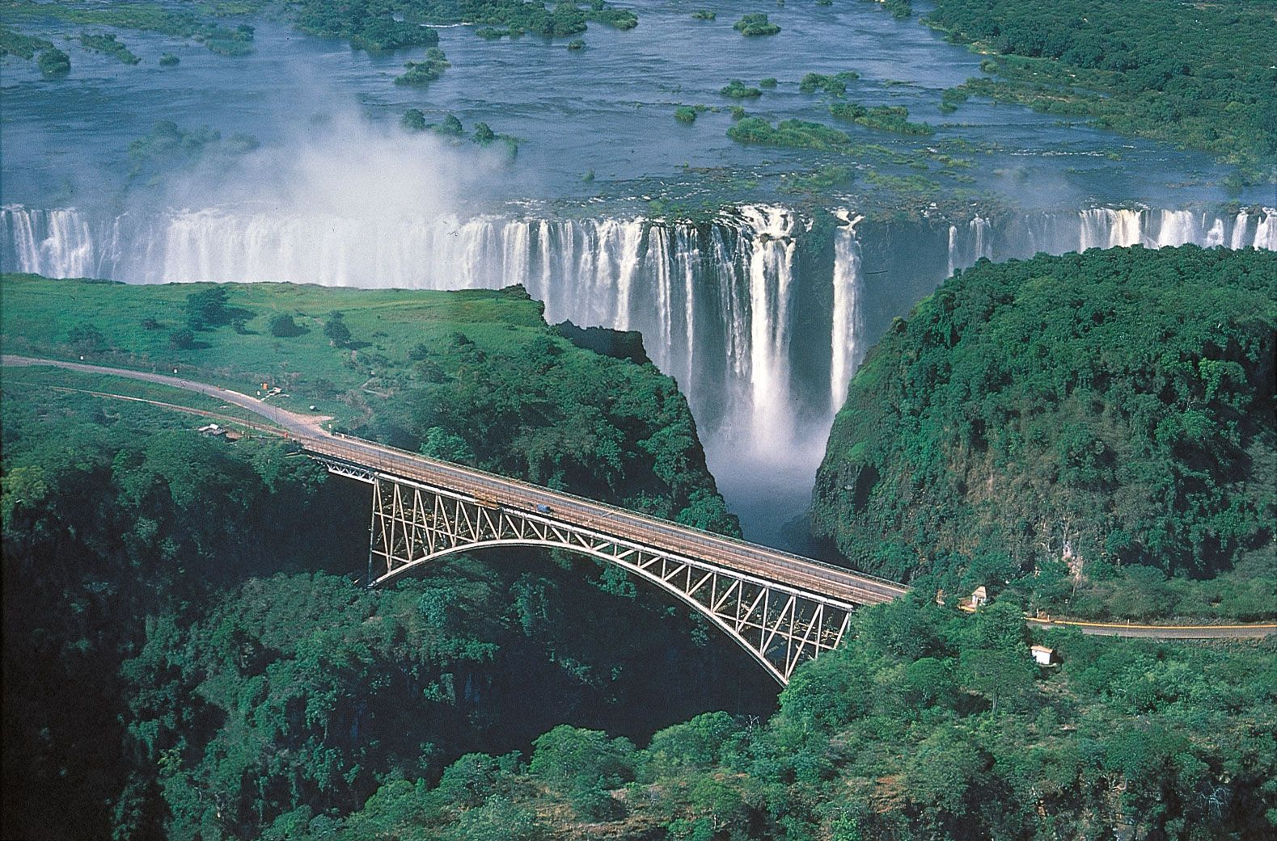
Thank you

