Slide 1

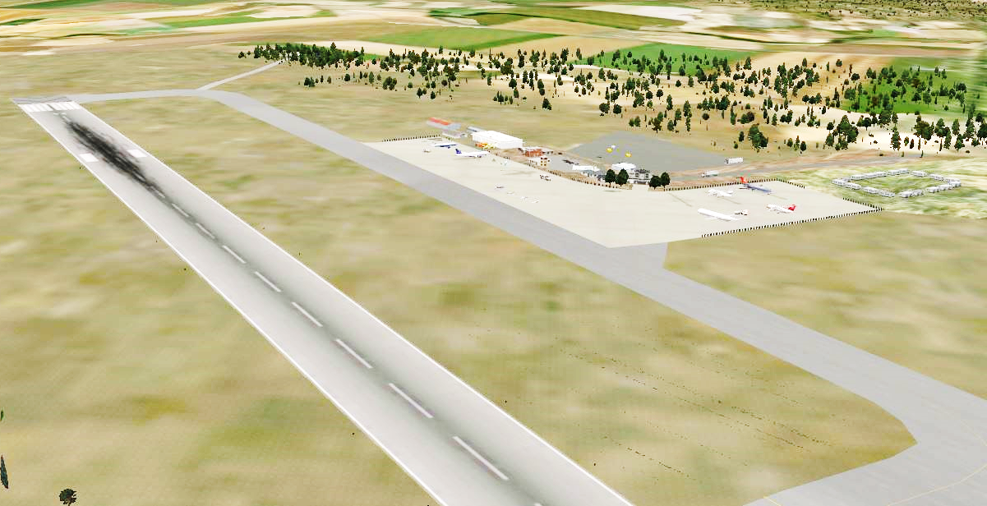

CIFOZ – AGM & CONGRESS 2-5 October 2024
SUSTAINABLE BUILT ENVIRONMENT
PUBLIC PRIVATE PARTNERSHIPS - ALTERNATIVE INFRASTRUCTURE PROCUREMENT
Eng. Sherman Chiswo

Slide 2
Contents
Introduction
Market Focus
Service Delivery
PPP Procurement
Project Experience
Pre-requisites
Opportunities
1. Contents
2. Market Focus
3. Service Delivery Issues
4. PPP Procurement
5. Project Experience
6. Pre-requisites
6. Opportunities
2

Slide 3




Key Expertise & Market Focus
1. Contents
Key expertise
Infrastructure transaction advisory
Feasibility studies
Project packaging
Project management
PPP Contract Management
Market Focus
Tourism
Culture
Sports
Energy
Transport
Water
Accommodation
Waste
ICT
2. Market Focus
3. Service Delivery Issues
4. PPP Procurement
5. Project Experience
6. Pre-requisites
6. Opportunities
www.horstein.com

Slide 4
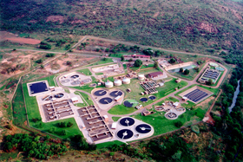
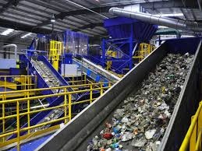


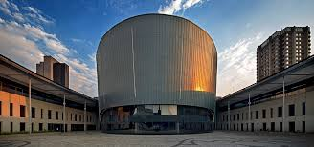
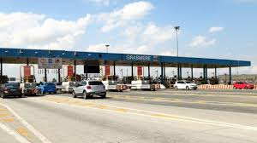
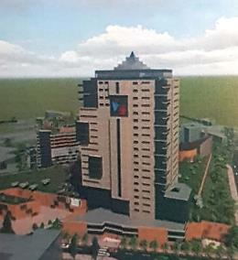
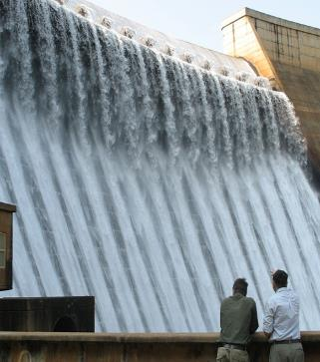
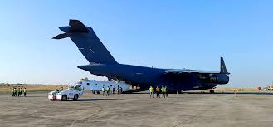

Project Experience
4

Slide 5
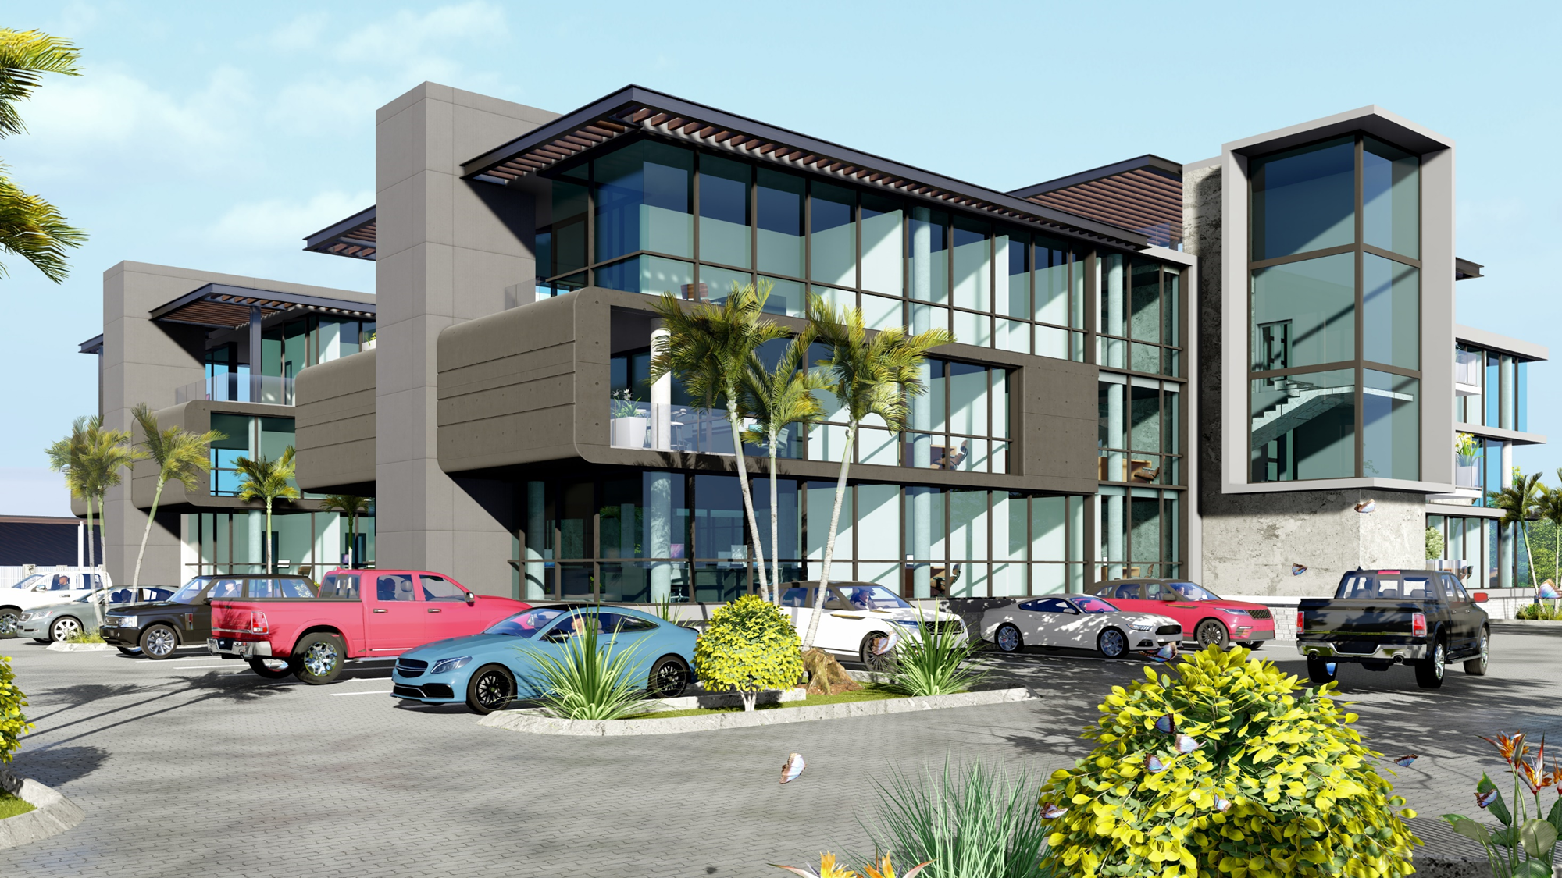
Project Experience
5

Slide 6
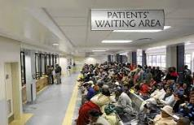
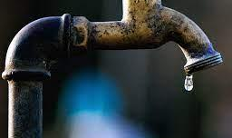

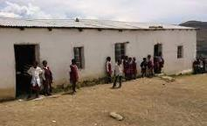
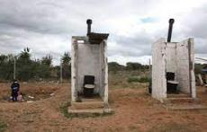
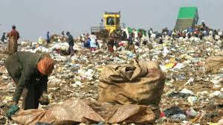
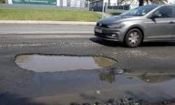

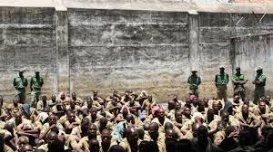
Service Delivery
Problem Statement
1. Contents
2. Market Focus
3. Service Delivery Issues
4. PPP Procurement
5. Project Experience
6. Pre-requisites
6. Opportunities
6

Slide 7
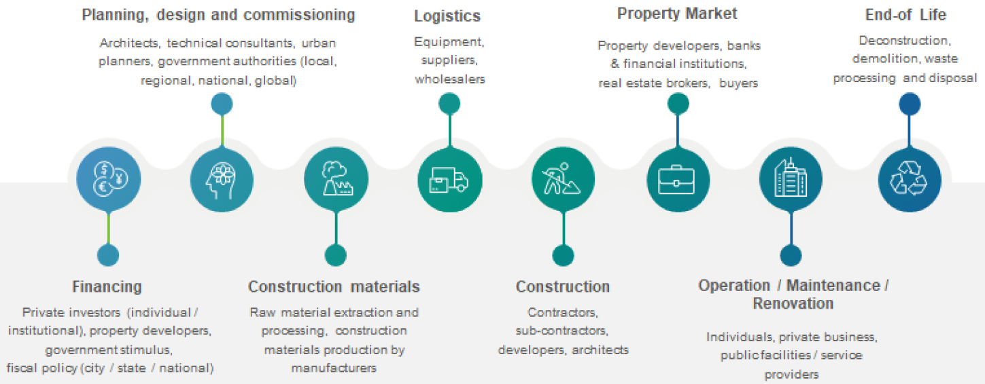
Construction Value Chain
7

Slide 8
PPP - Definition
Defining a PPP in Zimbabwe
WBG / ZIDA Definition – 5 pillars
Long-term contracts
Between a private party and a government entity
For providing a public asset or service,
Where the private party bears significant risk and management responsibility, and
Remuneration is linked to performance.
Same definition as in SA
1. Contents
2. Market Focus
3. Service Delivery Issues
4. PPP Procurement
5. Project Experience
6. Pre-requisites
6. Opportunities
8

Slide 9
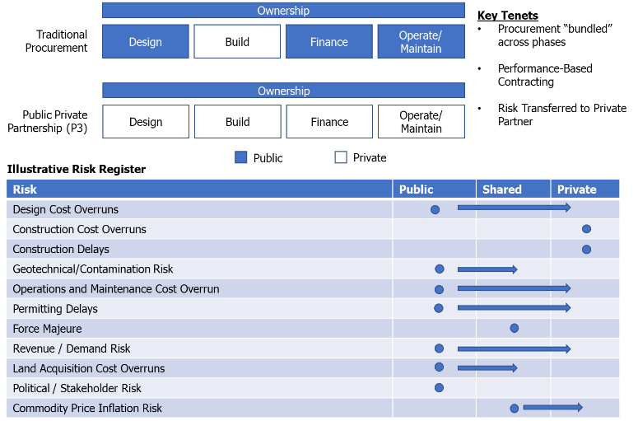
PPP Procurement
Structuring PPPs
1. Contents
2. Market Focus
3. Service Delivery Issues
4. PPP Procurement
5. Project Experience
6. Pre-requisites
6. Opportunities
9

Slide 10
PPP Procurement
Benefits
1. Contents
Structured process
Alternative financing of infrastructure
Upfront determination of affordability, risk allocation and VfM
Private sector capacity, expertise, efficiencies
Private sector funding, alleviates fiscal constraints
Innovation
Double layer of due diligence
Skills transfer
Contributions to economic growth
Community empowerment
SMMEs development
2. Market Focus
3. Service Delivery Issues
4. PPP Procurement
5. Project Experience
6. Pre-requisites
6. Opportunities
10

Slide 11
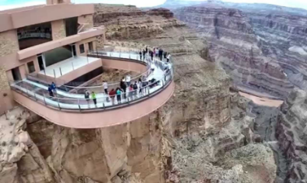
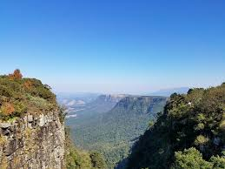
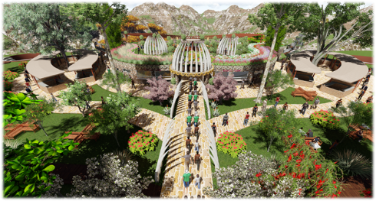
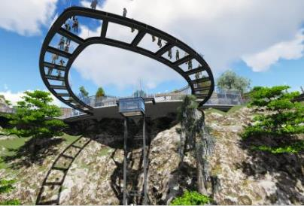
PPP Project Examples
Transaction Advisor Perspective
1. Contents
2. Market Focus
3. Service Delivery Issues
4. PPP Procurement
5. Project Experience
6. Pre-requisites
6. Opportunities
11

Slide 12
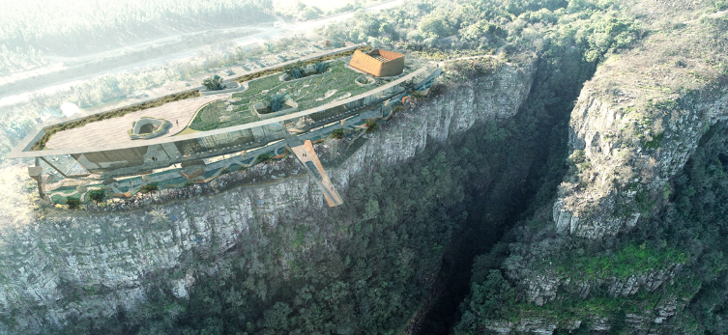
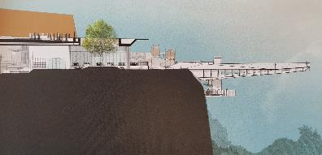
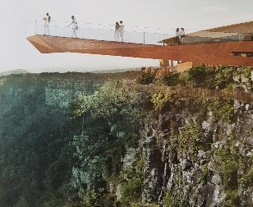
PPP Project Examples
Private Party Proposal
1. Contents
2. Market Focus
3. Service Delivery Issues
4. PPP Procurement
5. Project Experience
6. Pre-requisites
6. Opportunities
12

Slide 13
PPP Project Examples
God’s Window Skywalk – Contract Particulars
1. Contents
Design, Build, Finance, Operate, Transfer (DBFOT)
Capital investment R500 million
Development period: 3 years
25-year operating period
RFP required:
10% equity stake for the community
30% after 10 years and 70% after 20 years
Private Party offered the 10% to community for free
570 jobs created during construction
200 jobs anticipated during operations
Preferential procurement
SMMEs development
Financial close: 20 June 2023
2. Market Focus
3. Service Delivery Issues
4. PPP Procurement
5. Project Experience
6. Pre-requisites
6. Opportunities
13

Slide 14

PPP Project Examples
High Altitude Training Centre – Belfast, Mpumalanga
1. Contents
2. Market Focus
3. Service Delivery Issues
4. PPP Procurement
5. Project Experience
6. Pre-requisites
6. Opportunities
14

Slide 15
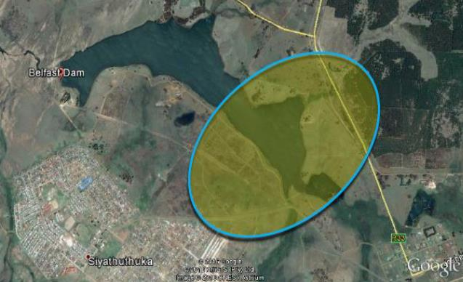
PPP Project Examples
High Altitude Training Centre – Belfast, Mpumalanga
1. Contents
2. Market Focus
3. Service Delivery Issues
4. PPP Procurement
5. Project Experience
6. Pre-requisites
6. Opportunities
15

Slide 16
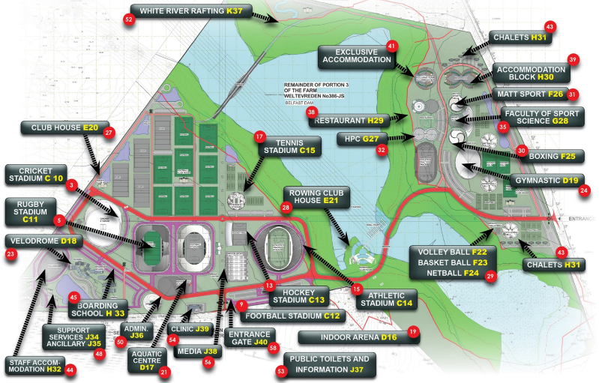
PPP Project Examples
High Altitude Training Centre – Belfast, Mpumalanga
1. Contents
2. Market Focus
3. Service Delivery Issues
4. PPP Procurement
5. Project Experience
6. Pre-requisites
6. Opportunities
16

Slide 17
PPP Project Examples
High Altitude Training Centre
1. Contents
Design, Build, Finance, Operate, Transfer (DBFOT)
Initiated by Provincial Government on traditional procurement
Capital investment R5,2 billion
Development period: 5 years
30-year operating period
1020 jobs created during construction
550 jobs anticipated during operations
Preferential procurement
SMMEs development
Current status:
Bulk services construction in progress
Project Appraisal
2. Market Focus
3. Service Delivery Issues
4. PPP Procurement
5. Project Experience
6. Pre-requisites
6. Opportunities
17

Slide 18
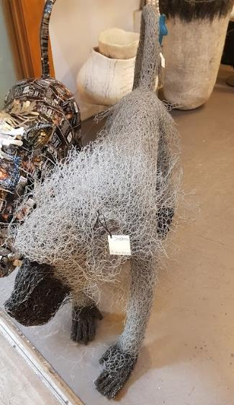

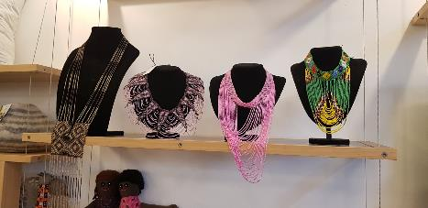
PPP Project Examples
Cultural and Creative Industry Hub, White River
1. Contents
2. Market Focus
3. Service Delivery Issues
4. PPP Procurement
5. Project Experience
6. Pre-requisites
6. Opportunities
18

Slide 19
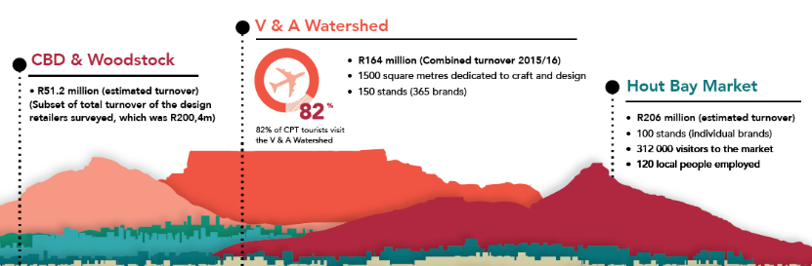
PPP Project Examples
Cultural and Creative Industry Hub
1. Contents
2. Market Focus
3. Service Delivery Issues
4. PPP Procurement
5. Project Experience
6. Pre-requisites
6. Opportunities
19

Slide 20
PPP Project Examples
Cultural and Creative Industry Hub
1. Contents
Design, Build, Finance, Operate, Transfer (DBFOT)
Initiated by Provincial Government on traditional procurement
Capital investment R1.2 billion
Development period: 3 years
25-year operating period
650 jobs created during construction
375 jobs anticipated during operations
Preferential procurement
SMMEs development
Current status: Procurement Phase
2. Market Focus
3. Service Delivery Issues
4. PPP Procurement
5. Project Experience
6. Pre-requisites
6. Opportunities
20

Slide 21
Pre-requisites
1. Contents
Macroeconomic stability
Long term finance
Attraction of FDI, investment protection
Development Finance Institutions (DFIs) support
PPP Unit, effective PPP approval process
Transaction Advisors
Project Preparation Fund
Pipeline of bankable projects
Benchmarking
2. Market Focus
3. Service Delivery Issues
4. PPP Procurement
5. Project Experience
6. Pre-requisites
6. Opportunities
21

Slide 22
Opportunities
1. Contents
CIFOZ - partnerships
Creation of a PPP market – stability, ringfence for investment
Formalise engagement with ZIDA
PPP Unit
Access to opportunities, us$ 2bn towards construction 2023
Capacitation of contractors, best practice 15 to 30% equity investment in PPPs
Toolkits – Water, Solid Waste & Tourism
Training
Capacity of the economy: best practice 10% of GDP
2. Market Focus
3. Service Delivery Issues
4. PPP Procurement
5. Project Experience
6. Pre-requisites
6. Opportunities
22

Slide 23
THANK YOU
www.horsteinprojects.com

