Slide 1


Joey Shumbamhini
0776984246

Slide 2

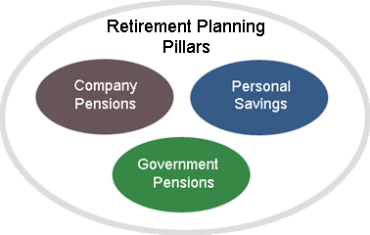
General retirement pillars according to world bank
World Bank Retirement Pillars

Slide 3
Retirement with hard labour
The above 3 Retirement Pillars are a very good start particularly if the Pension is in US$ (Nostro??)
However, Reliance on the above 3 World Bank Retirement Pillars is very dangerous
You risk plunging into POVERTY the day you retire
The first day you retire will be your FIRST day at work
We call it Retirement With Hard Labour

Slide 4
UDCORP ACT[Chapter 29:16] of 1986.
PREAMBLE
AN ACT :
to provide for the declaration of development areas;
to establish the Urban Development Corporation and to provide for the functions thereof;
to provide for the constitution and functions of the Urban Development Board;
to regulate the financial affairs of the Urban Development Corporation; and
to provide for matters incidental to and connected with the foregoing.

Slide 5
UDCORP ACT[Chapter 29:16] of 1986.
OBJECTS & FUNCTIONS
To encourage and assist local authorities and regional planning councils and local planning authorities established in terms of the Regional, Town and Country Planning Act [Chapter 29:12] to plan and co-ordinate urban growth and development within development areas;
To generate employment and encourage the development of commerce and industry within development areas;
To assist in the provision of housing and social facilities within development areas to encourage people to live and work therein;

Slide 6
UDCORP ACT[Chapter 29:16] of 1986.
OBJECTS & FUNCTIONS
d) To create and ensure the maintenance of an attractive environment within the development area;
e) To provide all forms of assistance, including financial or technical assistance, management counselling, training, auditing and other services, information or advice, to:
f) Local Authorities; and Co-operatives and commercial, industrial or other enterprises; in connection with urban development.

Slide 7
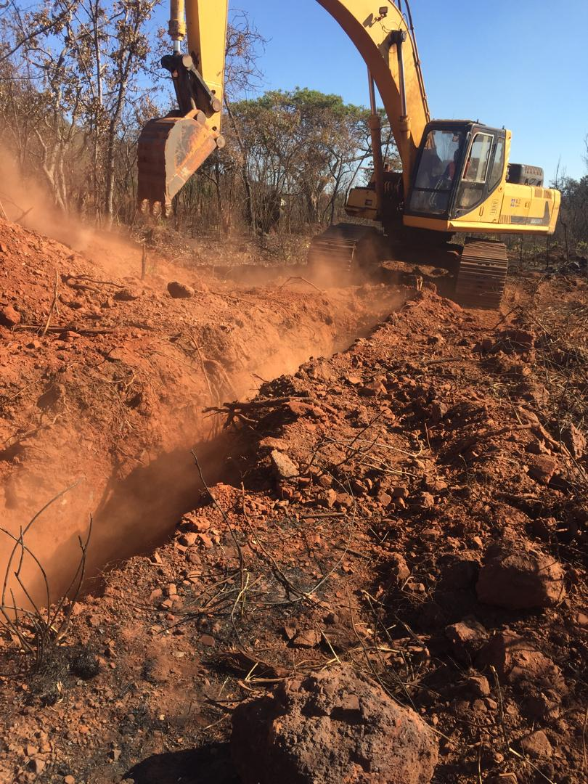
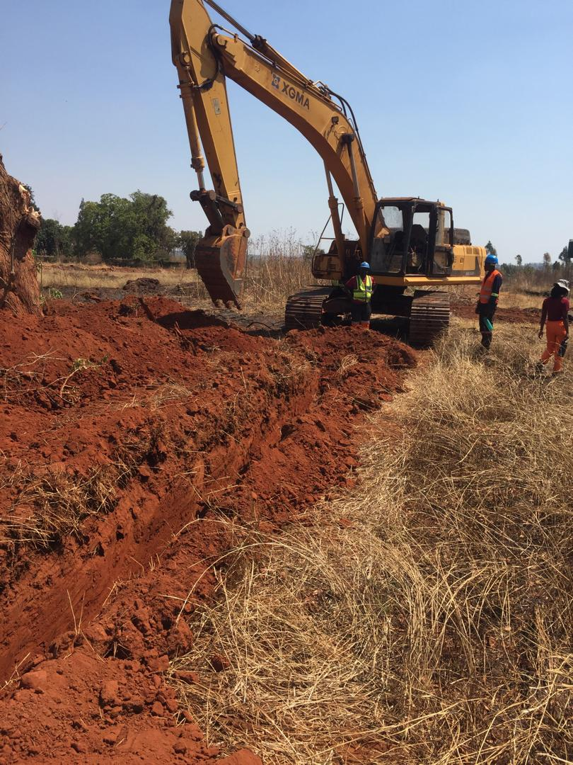
Knockmalloch housing development
CURRENT WORKS-SEWER TRENCHING (PHASE 1)

Slide 8
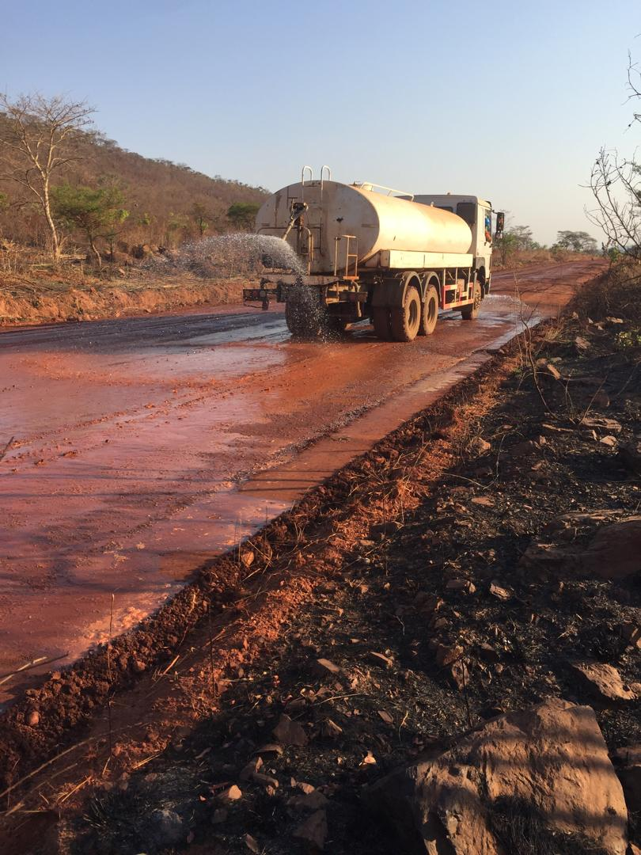
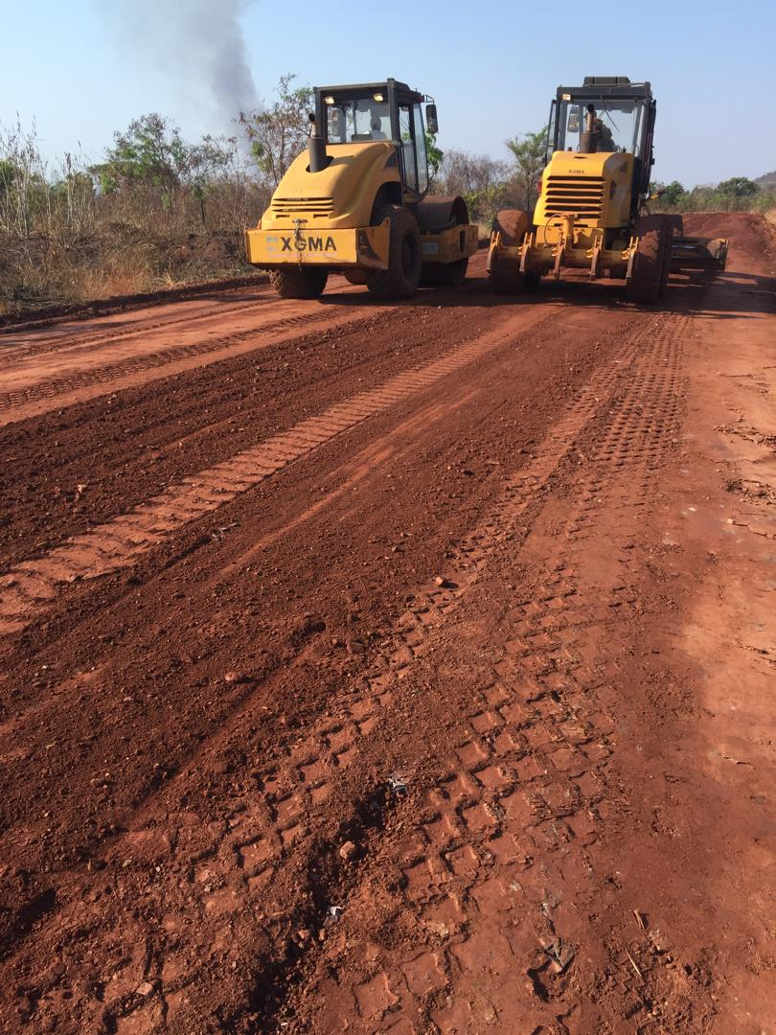
Knockmalloch housing development
CURRENT WORKS-roads skimming and compaction

Slide 9
High demand for residential stands from corporates
Latest Corporate Stand Sales – Offers were received from:
Client | No. | Progress update
1 | 135 Stands | Deposit already paid
2 | 60 stands | Proforma invoice issued Payment option communicated Client consulting OPC-CGU Draft agreement of sale to be sent immediately after client confirms offer,
3 | 296 stands | Site visits done Staff lists sent Allocation in progress Waiting for draft agreement of sale
4 | 150 stands/ | Expression of interest letter received.

Slide 10
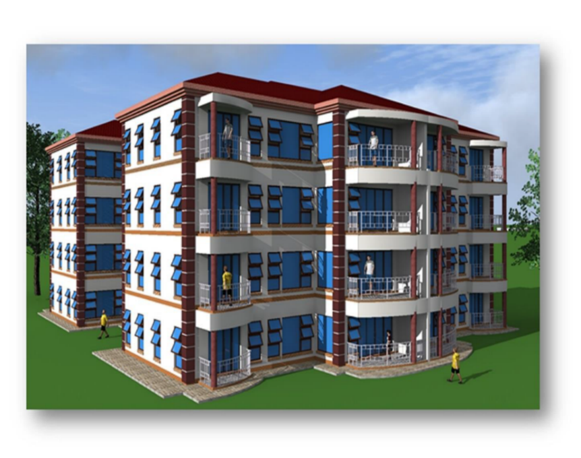
Manresa GOVERNMENT VILLA–phase 2
7 More Blocks to be built under phase 2
7 Blocks to house 112 Civil Servants (112 Families).
UDCORP is inviting Local Financial Institutions and Private Investors for Partnerships in this Project
Harare Manresa Government Villa to pave way for UDCORP to lobby for MORE similar projects in other Provinces.

Slide 11
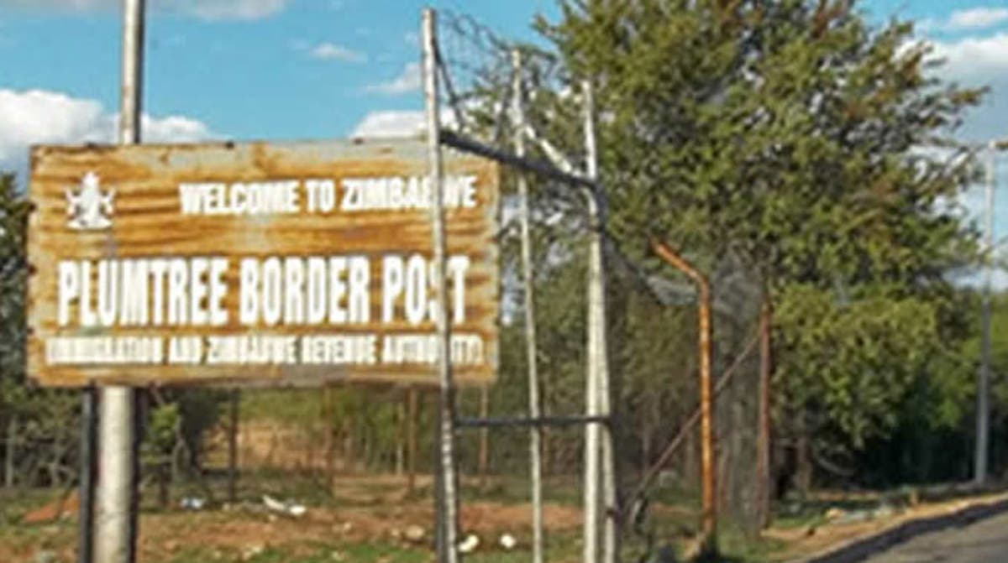
UNLOCK VALUE FROM EXISTING UDCORP LAND BANK
NEW HOUSING DEVELOPMENT
(PLUMTREE, HWANGE, KARIBA
Plumtree
Construction of 3 blocks of flats (48 units).
Target – to commence in H1 2025
Proposed Name – Palm Trees Villa
UDCORP is calling upon Local Financial Institutions and Private Investors for Partnerships in this Project

Slide 12
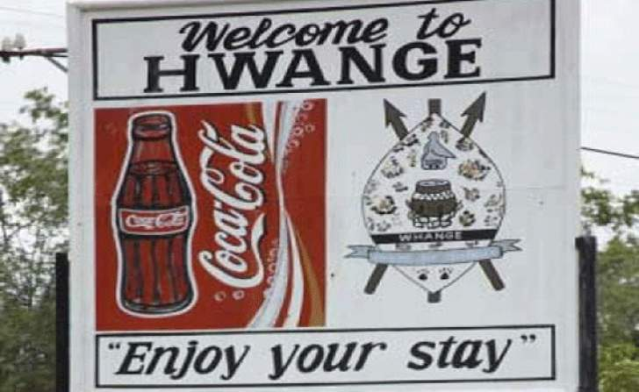
Other pipeline projects outside Harare
Hwange empumalanga phase 111 flats
Construction of 9 blocks of flats (144 units).
UDCORP is calling upon Local Financial Institutions and Private Investors for Partnerships in this Project
Hwange

Slide 13
Mobilize Resources from the Private Sector, Local & Regional Financial Institutions.
UDCORP as the partner of choice for the government
Government – Provides Land to UDCORP
UDCORP
Provides Resources Mobilisation, Technical Services Project Management Services
Local & Regional Financial Institutions
Pension Funds
Land Developers
Private Sector

Slide 14

Thank you for the support
0776984246

